Slide 1


Raising money without VC

Slide 2

Riasing money without VC
1-What is a VC?
2- What are the advantages of a VC?
3-What are the desadvantages of a VC?
5-The 5 Mondels to raise money without a VC

Slide 3


1. What is VC?
VC stands for Venture Capital
‘‘Venture Capital is money provided by investors to startup firms and small businesses with perceived long-term growth potential.‘‘ INVESTOPEDIA

Slide 4
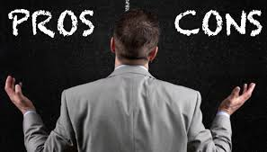
What are the advantages of a VC?
1-Easy access to capital
2-Mentor / Adviser
3-Business Growth
4-VC often provide HR Consultants
5-Connection with the business community

Slide 5
What are the desadvantages of a VC?
1- High amount of equity to be given away
2-Loosing control of the business
3-Internal problems with the VC management team
4-VCs do not release all the amount of the capital at once
5 VCs do not usually like to sign the non-disclosure agreement.

Slide 6
5 business models to raise money without VC
1-Mathc Maker Models
Examples: Airbnb, Lieferheld
2-Pay-In-Advance Models
Exemples: Dell
3-Subscription Models
Exemples: Nakedwines.com

Slide 7
5 business models to raise money without VC
4-Scarcity Models:
Exemple: Zara
5-Boostrap
Customer funded journey
Incubator, Crowdfunding
We hope you get ready to start with your journey using one of these models.

Slide 8
THANK YOU!!!!!!
Contact: ypierre@coperturalabel.com
yves.pierre@outlook.com

